Slide 1
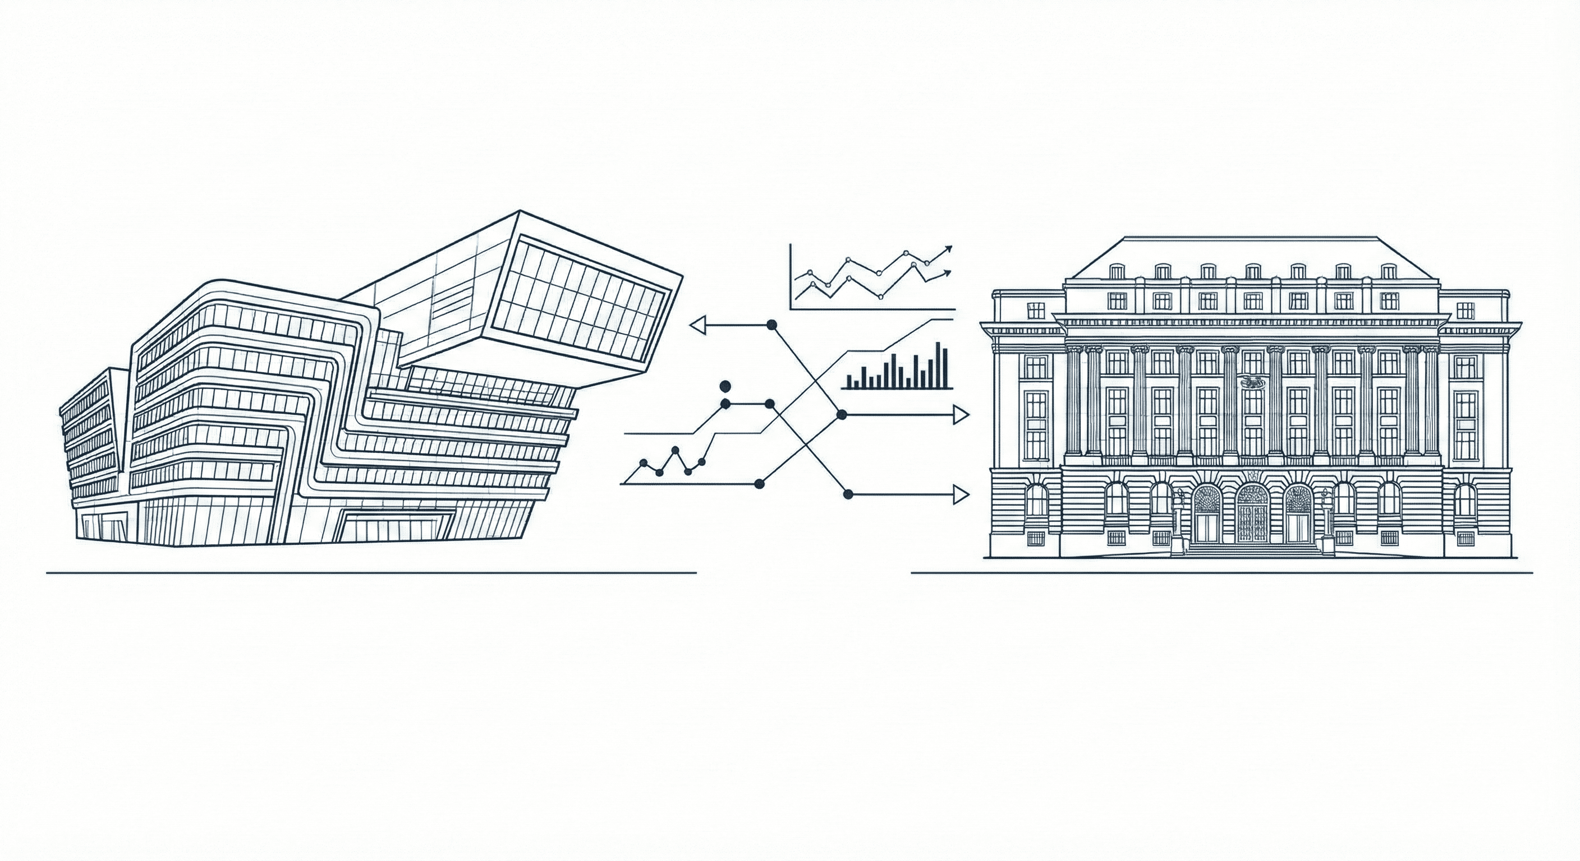


Protocol (20.01.2026) –
Credit Risk Modeling ILAB OeNB
By Anastasia Pryshchepa, Leonid Kuzmishin,
Tristan Leiter, Martin Yago Tortajada

Slide 2
Protocol (20.01.2026)
Summary
1) Univariate Analysis Results (Slide 5)
Check the results for sector (the binary encoded variables). How is the AUC-Score computed here?
2) Data Splitting (slide 7)
Rename „Default-Rate“ to „Proportion of Defaults“
3) Quantile Transformation (slide 8)
Gaussian Assumption does not matter – has no impact on the feature engineering nor modelling process.
We only require normality in the response variable, not for the inputs.
Remove the current motivation and methodology boxes.
4) Regularized GLMs | Calibration plots (slide 14, and others.)
Show the calibration plots (average predicted probability of default vs observed, split in deciles) also for
the different sectors and categories.
Mr. Leitner will forward the OeNB framework for showing the discrete folds
(instead of the current implementation via deciles).
5) NNs (slide 23)
Show the calibration plot instead of the ROC curve.

Slide 3
Protocol (20.01.2026)
Summary
6) Outlook (slide 29)
Add visual representations – Prob. of default for the base learners to understand how
shrinkage actually looks like.
Include more information about the models: feature importance, and others.
Include partial dependence plots (showing bivariate interactions and the marginal responses
one feature at a time); Scatterplots can also be used to show how similar the predictions are. Hexagonal binning.
Explain what XGBoost „sees“ in contrast to the other models. Find specific exemplary balance sheets
to find out what XGBoost catches.
Try out the „hdo“ package for variational autoencoders (feature compression on the raw positions).
A previous group achieved a strong result using the hdo package together with GLM modeling.
Try out GLM with untransformed vs transformed features.
Look at two balance sheet items and see if the marginal response is the same across models.
Different gradient boosting methods (CatBoost, LightGBM, etc.) would also be interesting.
7) General remarks
Chart labeling needs to be corrected. Axis elements are not clearly visible when presented via a beamer.

